Slide 1
Homework Check- 5 min
1) Screw- Bottle Cap
2) A wedge work like a ramp (inclined plane) but instead of moving an object from here to there, it pushes it apart.
3) In levers, you can find fulcrum in the middle. The fulcrum is a point at which the lever moves.
4)Water faucet knob is an example to wheel and axle.
5) Inclined plane

Slide 2
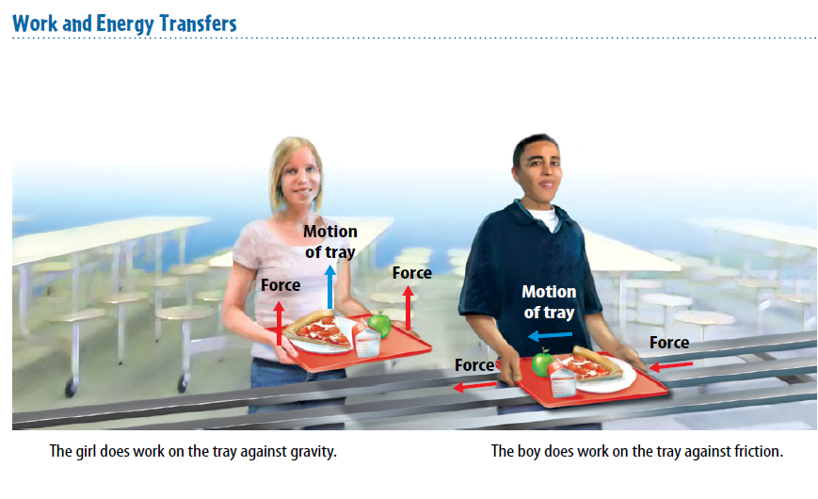
Warm Up 3 minutes 5-8-18 Tuesday Explain the picture. How does these two people do work?

Slide 3
Today Agenda
1) Homework Check 5 minutes
1) Warm up 3 minutes
2) Lesson 1; Content Vocabulary 5 minutes
3) Lesson Outline; 10 minutes
4) Key Concept Builder 10 minutes
5) Content Practice- Classwork (Grade) 15 min
6) Homework; Simple Machine and Work Part 2

Slide 4
Lesson 1 Vocabulary 5 min
power rate at which work is done
transfer to move from one place to another
work transfer of energy to an object by a force that makes an object move in the direction of the force

Slide 5
Lesson Outline Lesson 1: Work and Power
A. What is work?
1. Work is the transfer of energy to an object by a force that makes an object move in the direction of the force.
2. A weightlifter does work when exerting a force that makes weights move, but does no work to hold weights in place because the weights are not moving.
B. Calculating Work
1. You must know two things to calculate work––force and distance.
a. The force must be in newtons.
b. The distance must be in meters.
2. A newton-meter is also called a(n) joule, which is the unit of work.
3. The work equation uses the distance that the force acts on the object, not necessarily the total distance that the object moves.

Slide 6
B. Calculating Work
4. The work done on an object depends on the direction of the force applied and the direction of motion.
a. When the force on an object and the motion of the object are in the same direction, you multiply the total force times the total distance to determine the amount of work done.
b. When the force on an object is at a(n) angle to the direction of motion of the object, you multiply only the part of the force that is in the direction of motion times the total distance to determine the amount of work done.
5. The weight of any object is due to the downward force of gravity on the object.
a. To lift an object, you must pull upward on the object with a force equal to the object’s weight.
b. The work done to lift any object is equal to the weight of the object multiplied by the distance the object is lifted.

Slide 7
C. Work and Energy
1. Doing work on an object transfers energy to the object.
2. Because doing work on an object requires that the object move, doing work on the object increases its kinetic energy.
3. Lifting an object increases the object’s gravitational potential energy.

Slide 8
D. What is power?
1. Power is the rate at which work is done.
2. Power is determined by dividing the work done by the amount of time needed to do the work.
a. In the power equation, work done is in joules.
b. In the power equation, time is in seconds.
c. In the power equation, power is in watts.

Slide 9
Key Concept Builder (page 18)
1. check mark
2. no check mark
3. check mark
4. check mark
5. no check mark
6. no check mark
7. check mark
8. check mark
9. moves
10. joule

Slide 10
Key Concept Builder (page 19)
1. 15 J
2. 1,680 J
3. 5,000 J
4. Yes; the force of gravity is pulling the leaf down, so gravity is performing work on the leaf.
5. the object’s weight
6. the part of the force that is in the same direction as the object’s motion

Slide 11
Key Concept Builder (page 20)
1. Moving objects have kinetic energy, so causing
an object to move increases its kinetic energy.
2. If you do work to increase the height of an
object above ground, you are increasing its
potential energy.
3. K
4. K
5. B
6. B
7. K

Slide 12
Key Concept Builder (page 21)
1. 50 W
2. 25 W
3. 30 W
4. work
5. energy

Slide 13
Content Practice 15 minutes
There are 15 questions (9 short answer, 6 fill in the blanks)
Each questions 6.6 point.
You cannot talk during the classwork or show your answer to other students.
Students who violate the rules will get 0.

Slide 14
Homework
Simple Machine search hunt homework

