Slide 1
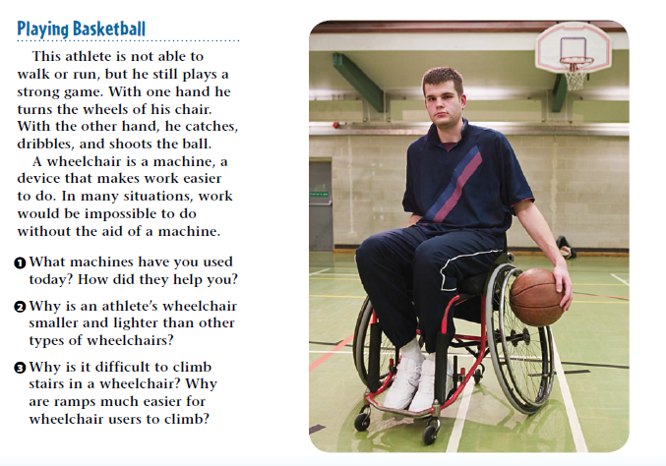
Warm Up 5 minutes 5/9/18 Wednesday

Slide 2
Warm Up Answer
1)Possible answers include motor vehicles, bicycles, doorknobs, eating utensils, pencils, ramps, and staplers.
2. Other wheelchairs are designed to carry people at walking speed or perhaps to be pushed by someone else. The lightweight and streamlined design of this wheelchair makes it efficient.
3. Unlike a person’s legs, a wheelchair is not easily lifted. But by rolling up a ramp, a wheelchair can gradually ascend a grade or hill.

Slide 3
Today Agenda
Warm Up 5 minutes
Lesson Vocabulary 5 minutes
Lesson Outline 15 minutes
Content Practice 10 minutes
Brain Pop video and quiz (on Plicker) 12 minutes
Homework (School to Home)

Slide 4
Lesson 2 Vocabulary
Efficiency ratio of output work to input work
Mechanical advantage ratio of output force to input force
You can use the lesson outline page 2 space for the vocabulary.

Slide 5
Lesson Outline for Teaching- Lesson 2 Using Machine
A. What is a machine?
1. A(n) machine is any device that makes doing something easier.
2. Although a machine makes doing work easier, it does not decrease the amount of work required.
3. A machine changes the way in which work is done.
4. To use a machine, you must apply a(n) force to it.
a. The machine changes the input force to a(n) output force.
b. When a hammer removes a nail, the input force comes from pulling on the hammer’s handle; the hammer changes this to a(n) output force that pulls the nail from the board.
5. When you use a machine, the input force makes part of the machine move.
a. Work is done because the input force causes movement.
b. Machines convert input work to output work.

Slide 6
A. What is a machine?
B. How do machines make work easier to do?
1. A machine can make work easier in three different ways.
2. A machine can make it easier to do work by changing the size of the force.
a. A machine can change a(n) input force into a(n) large output force.
b. The output force acts over a(n) shorter distance than the input force does.
3. A machine can make it easier to do work by changing the distance over which the force acts.
a. With a rake, your hands move through a(n) short distance, but the other end of the rake moves through a(n) greater distance.
b. As the output force exerted by any machine decreases, the output distance increases.
4. A machine can make it easier to do work by changing the direction of the input force.

Slide 7
C. What is mechanical advantage?
1. A machine’s mechanical advantage is the ratio of the output force produced to the input force applied.
2. A mechanical advantage greater than 1 means the output force is greater than the input force.
3. A mechanical advantage less than 1 means the output force is less than the input force.
4. A mechanical advantage equal to 1 means the input force and the output force are equal, but the direction of the input force changes.

Slide 8
D. What is efficiency?
1. The output work done by a machine never exceeds the input work of the machine.
2. The efficiency of a machine is the ratio of the output work to the input work.
3. Because the output work is always less than the input work, the efficiency of a machine is always less than 100 percent.

Slide 9
Content Practice- Guided Practice
Content Practice A (page 32)
1. machine
2. input force
3. output force
4. task
5–6. (in either order) size, direction
7. distance
8–9. (in either order) mechanical advantage, efficiency
10. mechanical advantage, output force, input force

Slide 10
Content Practice B (page 33)
1. decrease, work
2. output work, output force, distance
3. mechanical advantage, output force, input force
4. efficiency, output work, input work, friction
5. (in any order) by changing the size of a force, by changing the distance over which a force acts, by changing the direction of a force
6. lubricants

Slide 11
Brain Pop- Levels 2;40
https://www.brainpop.com/technology/simplemachines/levers/

Slide 12
Homework
School to Home 4 questions.

