Slide 1
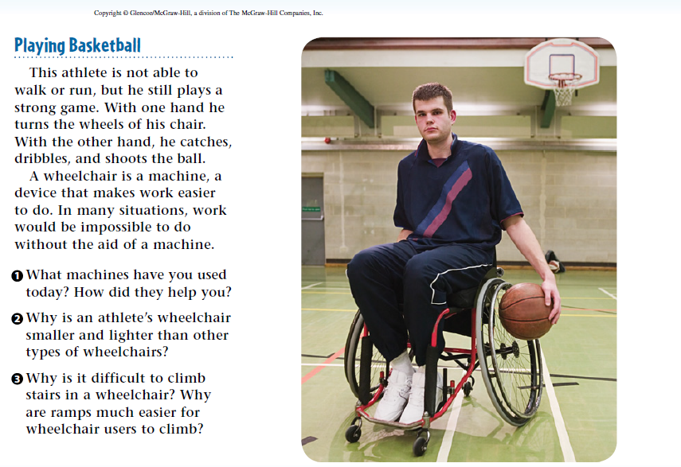
5/8/19 Wednesday 3 min

Slide 2
Today Agenda
1) Warm Up 3 min
2) Lesson Outline 15 min (Lesson 2- Using Machines)
3) Video 5 min
4) Plicker 20 min
Important Reminder
1) Weekly Homework due is Friday
2) Simple Machine and Work Quiz is Friday.

Slide 3
Lesson Outline- A. What is a machine?
1. A(n) machine is any device that makes doing something easier.
2. Although a machine makes doing work easier, it does not decrease the amount of work required.
3. A machine changes the way in which work is done.
4. To use a machine, you must apply a(n) force to it.
a. The machine changes the input force to a(n) output force.
b. When a hammer removes a nail, the input force comes from pulling on the hammer’s handle; the hammer changes this to a(n) output force that pulls the nail from the board.
5. When you use a machine, the input force makes part of the machine move.
a. Work is done because the input force causes movement.
b. Machines convert input work to output work.

Slide 4
B. How do machines make work easier to do?
1. A machine can make work easier in three different ways.
2. A machine can make it easier to do work by changing the size of the force.
a. A machine can change a(n) input force into a(n) large output force.
b. The output force acts over a(n) shorter distance than the input force does.
3. A machine can make it easier to do work by changing the distance over which the force acts.
a. With a rake, your hands move through a(n) short distance, but the other end of the rake moves through a(n) greater distance.
b. As the output force exerted by any machine decreases, the output distance increases.
4. A machine can make it easier to do work by changing the direction of the input force.

Slide 5
C. What is mechanical advantage?
1. A machine’s mechanical advantage is the ratio of the output force produced to the input force applied.
2. A mechanical advantage greater than 1 means the output force is greater than the input force.
3. A mechanical advantage less than 1 means the output force is less than the input force.
4. A mechanical advantage equal to 1 means the input force and the output force are equal, but the direction of the input force changes.

Slide 6
D. What is efficiency?
1. The output work done by a machine never exceeds the input work of the machine.
2. The efficiency of a machine is the ratio of the output work to the input work.
3. Because the output work is always less than the input work, the efficiency of a machine is always less than 100 percent

Slide 7
Video
https://www.youtube.com/watch?v=yhzMYHiuEC4

Slide 8
Plicker

