Slide 1
Warm Up 4 min 8/22/18 Wednesday
Please be seated and quiet.
1.Write the name of the three places that you traveled during the summer break.

Slide 2
Today Agenda
1) Warm Up 4 min
2) Introduction Mr.Ilbay 5 min
3) Classwork- Who am I? 10 min
4) Syllabus and Expectation 25 min
5) Homework- Syllabus. (Last Page needs to return and signed- Due date is this Friday 8/24/18)
6) Friday 7th Grade Pre-Test on Science (8/24/18)

Slide 3
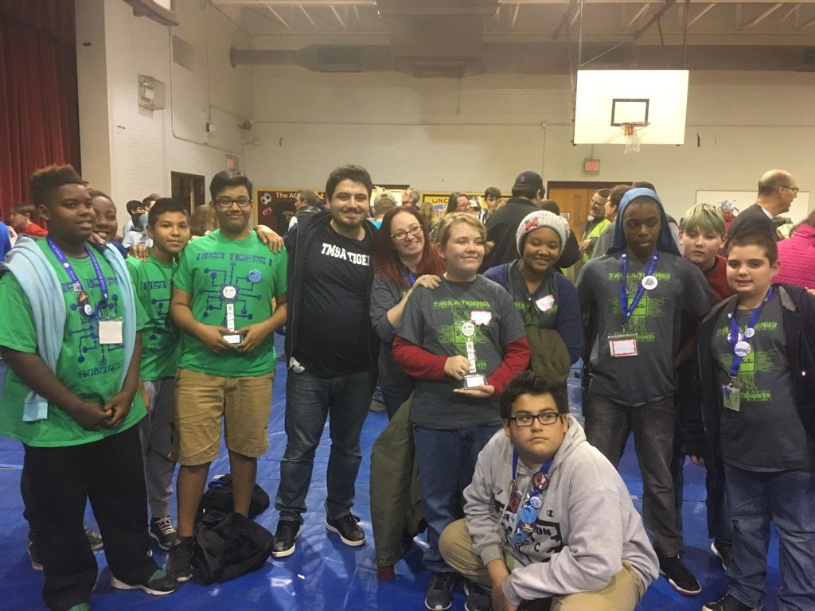
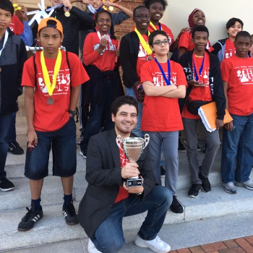
WELCOME– 7TH GRADE SCIENCE
MR.ILBAY (IL-BY)

Slide 4
WHO AM I ?
I am your new science teacher for this year. I am looking forward to excellent school year in which is my fifth year in TMSA. (2 years at elementary, 3 years at main campus)
My name is Mr. Ilbay. I am from Turkey.
Undergraduate; Science Education Hacettepe University (2012)
Started work at TMSA 2013-2014 school year
Graduate; NC A&T MS Instructional Technology- 2018
Professional Teaching Licensure (2014) SP2 (6-12 Science Education)
I just got married July 12 2017 and expecting a baby girl first week of October 2018.

Slide 5
Your Turn- Who I am 10 min
Instruction
You don’t need to draw your self- portrait
My ethnicity/race/culture; e.x White, African-American, Hispanic, Pacific Islander, Asian etc.
Graduating Class; 2020- 8th Grade 2024 High School etc.
You don’t need to write the information if you don’t feel comfortable. Thank you.

Slide 6
Course Outline
Forces and motion
Energy; transfer and conservation
Earth system and processes
Structures and functions of living organism
Genetics and Evolution

Slide 7
Materials
Textbook- Holt Science
Notebook, Binder
Pencils
Colored pencil, scissors, ruler, glue, calculator

Slide 8
Course Evaluation and Grading Scale
Grading Scale | Course Evaluation
90-100 A | Tests 30%
80-89 B | Projects 20%
70 - 79 C | Classwork/Homework/Lab 25%
60-69 D | Quizzes 15%
Below F | Participation 10%

Slide 9
Homework Policy
Homework will be assigned 2-3 times a week. Homework assignments will always be posted on the white board in the classroom and http://ailbay.weebly.com.
No late work will be accepted without an official excuse.
If a student turns in homework after the due date, 10 points will be deducted for each late day. (NO late homework from previous week)

Slide 10
Classroom Expectations
Be on time and prepared for class.
Enter the room quietly and begin the warm-up immediately.
Listen. Do not talk while the teacher is talking.
Refrain from participating in horse play.
Raise your hand to speak or move.
Do not use inappropriate language.
Follow directions the first time given.
Complete all given assignments and tasks on time.
Expect to be successful.
Do not take matters into your own hands.
NO SIDE BAR CONVERSATIONS.

Slide 11
Consequences
Reminder and verbal warning
Conference with Students
Isolation and discipline form (Silent Lunch or Recess)
PARENT CONTACT/Office referral

Slide 12
REFOCUS
Refocus is student based behavior correction plan.
The more you get in trouble, the more paperwork you do.
Two forms in the same class period means an immediate call home.

Slide 13
3 interesting facts about yourself
2 things that you could do that would make you a better person this academic year.
1 thing you regret from last year.

Slide 14
As your teacher my job is NOT...
To make you learn.
To give you pencils.
To keep up with your stuff.
To let you call your mom.
To let you leave when you don’t have a planner.
To give you your locker combination if you forget.
To give you grades.
To let you fail.

Slide 15
As your teacher my job is...
To CARE about you.
To RESPECT you.
To explain things in a way that ever one understands.
To push you to reach your FULL potential.
To cultivate the innate talents and abilities of all students.
To provide you with high quality Algebra 1 instruction.
To prepare you for high school and for a productive adult live.

Slide 16
Expectations – Young Men
Conduct you self like an upstanding young man at all times.
Keep your pants up on your waist with a belt and your shirt tucked in.
In school use proper language. I can’t so you can’t. You would report me so, I will report you.
Be the very BEST that you can be.

Slide 17
Expectations – Young Ladies
Conduct you self like an upstanding young lady at all times.
Respect your young womanhood at all time.
In school use proper language. I can’t so you can’t. You would report me so, I will report you.
Be the very BEST that you can be.

Slide 18
The tenants of our profession.
RESPECT
DISCIPLINE
COURAGE
PERSAVERENCE

Slide 19
The tenants of our profession.
RESPECT is defined as: Proper courtesy.
DISCIPLINE is defined as: Control over oneself.
COURAGE is defined as: In spite of one’s own fear, doing the right thing.
PERSAVERENCE Is defined as: Continuing in a course of action without regard to discouragement, opposition or previous failure.

Slide 20
RESPECT
In your table group, construct a definition for the term respect. All members are required to agree on the final product.
Construct a list of three people you have shown respect to and why.
Construct a parallel list of three people you have disrespected and why.
Develop 2 skits, one the demonstrates respect and one that demonstrated disrespect.
What are some way teachers disrespect students.
What are some ways students disrespect teachers.

Slide 21
Discipline
In your table group, construct a definition for the term Discipline. All members are required to agree on the final product.
Construct a list of three people that display good discipline, why?
Construct a parallel list of three people who display lack of discipline, why?
Develop 2 skits, one the demonstrates respect and one that demonstrated disrespect.
What are some way teachers disrespect students.
What are some ways students disrespect teachers.

