Slide 1
WARM UP 4 MINUTES 8/28/18 Tuesday
8-28-18 Tuesday
1) Write the steps of scientific method/ inquiry?

Slide 2
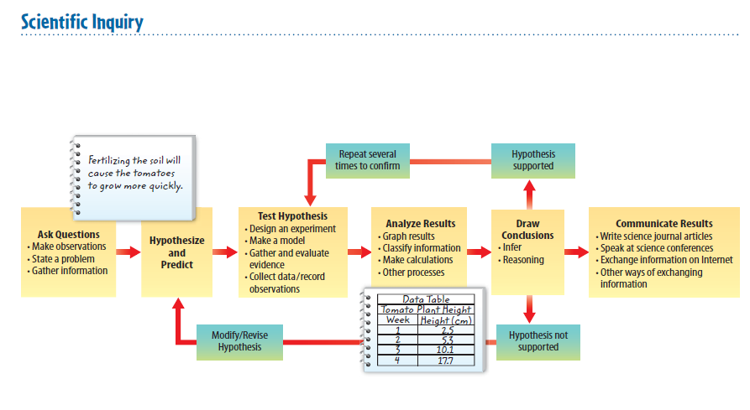

Slide 3
Today Agenda
1) Warm Up 4 minutes
2) Lesson Outline 15 minutes
3) Independent Practice 15 minutes
4) Brain Pop- Scientific Method 5 minutes
5) Review 5 minutes

Slide 4
Lesson 1- Understanding Science- Lesson Outline
A. What is science?
1. The investigation and exploration of natural events and of the new information that results from those investigations is called science.
2. Scientists observe the natural world and form questions about what they see.
3. Scientists use reliable skills and methods in problem solving.
B. Branches of Science
1. Life science, or biology, is the study of all living things.
2. Earth science is the study of Earth, including its landforms, rocks, soil, and forces that shape Earth’s surface.
3. Physical science is the study of chemistry and physics; physical scientists study the interactions of matter and energy.

Slide 5
Lesson 1- Understanding Science- Lesson Outline
C. Scientific Inquiry
1. As scientists study the natural world, they ask questions about what they observe.
2. Scientists practice scientific inquiry—a process that uses a variety of skills and tools to answer questions.
3. A scientist usually begins a scientific investigation by making a(n) observation, which involves gathering information.
4. A(n) inference is a logical explanation of an observation that is drawn from prior knowledge or evidence.
5. After making observations and inferences, scientists sometimes form a(n) hypothesis that can be tested by scientific investigation.

Slide 6
Lesson 1- Understanding Science- Lesson Outline
6. When a scientist forms a hypothesis, he or she usually makes a(n) prediction, or a statement about what will happen next in a(n) sequence of events.
7. Testing a(n) hypothesis often means testing predictions; if the prediction is confirmed, it supports the hypothesis, and if the prediction is not confirmed, the hypothesis might need revision.
8. Three ways to organize data are to create graphs, classify information, and make models and calculations.
9. Scientists must decide whether or not the data they have collected support their hypothesis.
10. Scientists might make more inferences when drawing conclusions.
11. Communicating results is important because scientists use new information in their research.

Slide 7
D. Results of Scientific Inquiry
1. Outcomes of scientific inquiry may include technology, new materials, and possible explanations for phenomena.
2. The practical use of scientific knowledge, especially for industrial or commercial use, is called technology.

Slide 8
E. Scientific Theory and Scientific Laws
1. An explanation of observations or events based on knowledge gained from many observations and investigations is called a(n) scientific theory.
2. A(n) scientific law describes a pattern or an event in nature that is always true.
3. It is important to be skeptical, or to question information, about scientific issues presented in the media.
4. Comparing what you already know with the information you are given in order to decide whether you agree with it is called critical thinking.
5. Science cannot answer questions about personal opinions, values, beliefs, or feelings.
6. Scientists follow safety procedures when they conduct investigations.
7. It is important to follow ethics when you work with living things or do research with people.

Slide 9
1
Independent Practice
10 minutes
Content Practice A
Content Practice B

Slide 10
1
Brain Pop Scientific Method
https://www.brainpop.com/science/scientificinquiry/scientificmethod/

Slide 11
1
Lesson Review- Key Concept Question Answer
Scientific inquiry, also known as the scientific method, is a collection of skills that scientists use in different combinations to perform scientific investigations.
Scientific investigations often result in new technology, new materials, newly discovered objects or events, or answers to questions.
A scientist can help prevent bias in a scientific investigation by taking random samples, doing blind studies, repeating an experiment several times, and keeping accurate and honest records.

Slide 12
1
Homework (School to Home- Lesson 1)

