Slide 1
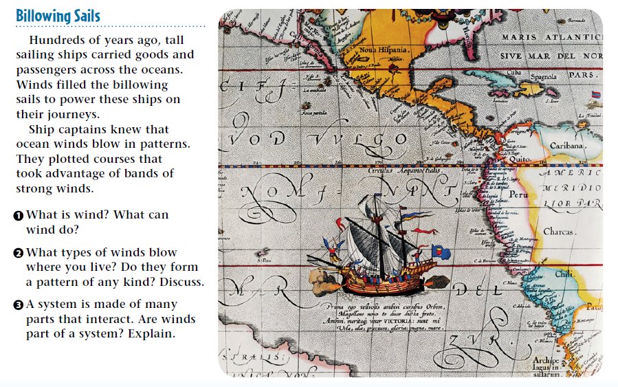
Warm Up 4 min 9-12-18 Wednesday

Slide 2
Warm Up Answer
1.Wind is moving air. Wind can power sailboats,
lift a kite, and spin wind turbines
2 Calm winds, strong winds, and winds that are part of severe storms.
3 Yes. Winds blow across Earth’s surface, and winds in one region affect winds elsewhere

Slide 3
Today Agenda
1) Warm up 4 min
2) Key Concept Builder 10 min
3) Content Practice 10 min
4) Study Guide- Chapter Test 10 min
5) Plicker (10 min )
6) Homework- Study Chapter Test on 9/18/18 Tuesday.

Slide 4
Key Concept Builder (page 54)
1. heating
2. surface
3. pressure
4. global
5. tropics
6. latitudes
7. local
8. land
9. sea

Slide 5
Key Concept Builder (page 55)
1. tropics
2. poles
3. warm, cold
4. angle
5. tropics
6. winds
7. night
8. cool
9. climate

Slide 6
Key Concept Builder (page 56)
1. C
2. G
3. B
4. H
5. A
6. D
7. E
8. F

Slide 7
Key Concept Builder (page 57)
1. the three-cell model
2. the troposphere
3. It rises in the area around the equator and sinks back to Earth
4. Cold air from the poles moves to north or south
5. It is caused by Earth’s rotation. The phenomenon is called the Coriolis effect

Slide 8
Content Practice A (page 51)
1. the three-cell model of global air circulation
2. polar easterlies
3. westerlies
4. trade winds
5. the doldrums
6. tropics
7. jet stream
8. Earth’s rotation
9. cold air
10. polar regions
11. land breeze
12. warm air

Slide 9
Content Practice B (page 52
1. You are in the doldrums. You should use the gasoline engine to travel straight south.
2. Both hemispheres have three huge wind belts.
3. The Coriolis effect is an apparent movement

Slide 10
Study Guide

Slide 11
Plicker

