Slide 1
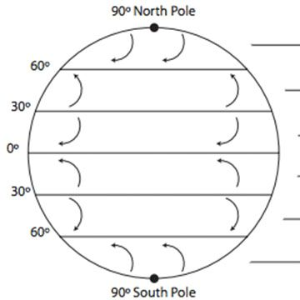
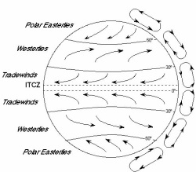
Warm Up 9-20-17 Wednesday 5 minutes
Fill in the blanks .

Slide 2
Today Agenda
1) Warm Up 5 minutes
2) Homework Check 5 minutes
3) Continue to Read to Learn Page 214-216 10 minutes
4) Content Vocabulary/ Lesson Outline 10 minutes
5) Review
6) Homework (After You Read)

Slide 3
Read to Learn
Open your textbook page 214-216

Slide 4
Content Vocabulary
1) Wind
2) Jet Stream
3) Westerlies
4) Land Breeze
5) Trade Winds
6)Polar Easterlies
7) Sea Breeze

Slide 5
Lesson Outline
A. Global Winds
1. The amount of energy an area receives is affected by the Sun’s angle.
2. More sunlight reaches Earth’s surface at the equator than at the poles.
3. Low air pressure is usually located over the tropics; high air pressure is usually located over the poles.
4. Wind is the movement of air from areas of high pressure toward areas of low pressure.
5. Global wind belts influence weather and climate throughout the world.

Slide 6
Lesson Outline
B. Global Wind Belts
1. Scientists use a model that has three wind cells to describe air circulation patterns in Earth’s atmosphere.
2. In the first cell, hot air at the equator moves to the top of the troposphere. Then the air moves toward the poles until it cools and moves back to Earth’s surface near the 30° latitude.
3. In the third cell, air from the poles sinks and moves along Earth’s surface toward the equator, warming up until it rises near the 60° latitude.
4. The first cell and the third cell are both driven by convection.

Slide 7
Lesson Outline
5 The second cell lies between the 30° and 60° latitudes and is driven by the motion of the other two cells.
6. All three cells exist on both sides of the equator, in the northern hemisphere and the southern hemisphere.
7. Global winds appear to curve due to the Coriolis effect.
a. The trade winds are steady winds that flow toward the equator from east to west between the 30°N and 30°S latitudes.
b. The westerlies are the prevailing winds that flow from west to east between the 60°N and 30°N latitudes and the 60°S and 30°S latitudes.
c. The polar easterlies are cold winds that blow from the east to the west near the North Pole and South Pole.

Slide 8
Lesson Outline
8. A(n) jet stream is a narrow band of high winds that are commonly near the top of the troposphere.
a. Jet streams flow from the west at up to 300 km/h, often making large loops from north to south.
b. Jet streams influence weather, moving cold air from the poles toward the equator.

Slide 9
Lesson Outline
C. Local Winds
1. Local winds occur when air pressure differs from one location to another.
2. A(n) sea breeze is a wind that blows from the sea to the land due to local temperature and air pressure differences.
a. On a sunny day, the air over land warms and rises, creating an area of low pressure. The air over the ocean does not warm as much; this cool air sinks, creating an area of high pressure.
b. The contrast in pressure causes a(n) cool wind to blow across the water toward the land.

Slide 10
Lesson Outline
3. A(n) land breeze is a wind that blows from the land to the sea due to local temperature and pressure differences.
a. At night, the land cools more quickly than the water, causing the air above the land to sink.
b. The high pressure over the land and low pressure over the water make the wind blow toward the water.

Slide 11
Homework
After you read. (two pages)

