Slide 1
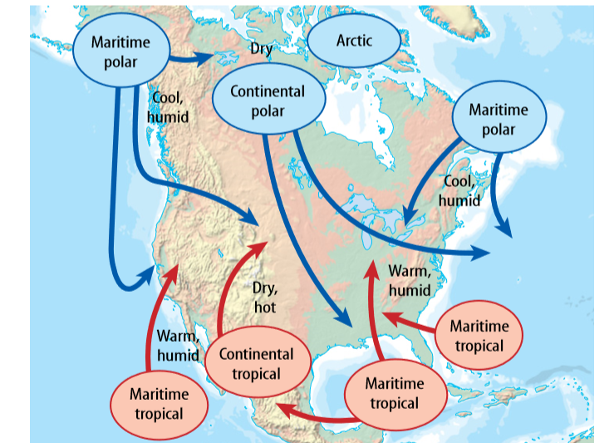
9/25/18 Tuesday Warm Up 4 min Write type of air masses and describe them.

Slide 2
Today Agenda
1) Bell Ringer 4 min
2) Lesson Vocabulary (Science Journal) 10 min
3) Lesson Outline (Worksheet) 10 min
4) Content Practice (Worksheet) 10 min
5) Video (3 min)
6) Plicker ( 7 min )
7) Homework ( Home To School )

Slide 3
Lesson Vocabulary (Lesson 2)- 10 min
air mass large body of air with distinct temperature and moisture characteristics
blizzard violent winter storm characterized by freezing temperatures, strong winds, and blowing snow
dominate to exert the guiding influence on
front boundary between two air masses
high-pressure system large body of circulating air that has high pressure at its center and lower pressure on the outside
hurricane intense tropical storm with winds exceeding 119 km/h
low-pressure system large body of circulating air that has low pressure at its center and higher pressure on the outside
tornado violent, whirling column of air that comes in contact with the ground

Slide 4
Lesson Outline for Teaching Lesson 2: Weather Patterns
A. Pressure Systems
1. A(n) low-pressure system is a large body of circulating air that has low pressure at its center and higher pressure on the outside.
a. Air moves from high pressure to low pressure.
b. In a low-pressure system, air moves away from the outside of the system.
c. Air in the center of the system rises, and the water vapor in it condenses and forms clouds.
2. A(n) high-pressure system is a large body of circulating air that has high pressure at its center and lower pressure on the outside.
High-pressure air at the center sinks and moves toward low-pressure areas.
b. High-pressure systems bring clear skies.
B. Air Masses
1. Air masses are large bodies of air that have distinct temperature and moisture characteristics.
2. An air mass forms when a(n) high-pressure system lingers in one area for a few days.
a. Continental polar air masses are cold and dry.
b. Maritime tropical air masses are warm and humid.
c. Arctic air masses are very cold and dry. They form over continents or arctic ice.

Slide 5
C. Fronts
1. A weather front is the boundary between two air masses.
2. A(n) cold front forms when a colder air mass moves toward a warmer air mass. It often brings severe storms and cooler temperatures.
3. A(n) warm front forms when a warmer air mass moves toward a cooler air mass.
a. As the warm air rises, water vapor condenses, and precipitation often occurs.
b. A warm front brings warmer temperatures and shifting winds.
4. A(n) stationary front forms when the boundary between two air masses stalls. It brings cloudy skies and light rain.
D. Severe Weather
1. A low-pressure system can provide the warm temperatures, moisture, and rising air needed for a(n) thunderstorm to form.
a. The cumulus stage of a thunderstorm starts with cloud formation and updrafts.
b. The mature stage of a thunderstorm contains heavy winds, rain, and lightning.

Slide 6
D. Severe Weather
c. During the dissipation stage of a thunderstorm, wind and rain subside.
d. Lightning is caused by oppositely charged particles in clouds and on the ground.
2. A violent, whirling column of air that contacts the ground is a(n) tornado.
a. Tornadoes form when updrafts from thunderstorms begin to rotate.
b. Tornado Alley is the name for the part of the United States that has the most tornadoes.
3. A(n) hurricane is an intense tropical storm with winds exceeding 119 km per hour.
a. Hurricanes typically form in late summer over warm, tropical oceans and are the largest type of severe storm.
b. When a hurricane moves over land or cold water, it loses energy.
4. A(n) blizzard is a severe winter storm, characterized by freezing temperatures, strong winds, and blowing snow.
5. The U.S. National Weather Service issues a(n) watch when severe weather is possible. It issues a(n) warning when severe weather is already occurring.

Slide 7
Content Practice A
1–5. (in any order) freezing rain, tornadoes, hurricanes, blizzards, thunderstorms
6–7. (in either order) temperature, humidity
8–11. (in any order) cold front, warm front, stationary front, occluded front

Slide 8
Content Practice B (page 31)
1. hurricane
2. air mass
3. maritime
4. front
5. low-pressure system
6. denser
7. warm
8. occluded
9. thunderstorm
10. thunder
11. continental
12. tornadoes
13. tropical
14. hurricane

Slide 9
Video
https://www.youtube.com/watch?v=o4lg8UfY5DM

Slide 10
Plicker

Slide 11
Homework (School to Home)
Lesson 2- Weather Patterns

