Slide 1
Warm Up 5 minutes
1)What are the weather variables ?
air pressure, humidity , relative humidity, dew point, temperature, wind,
2)What are four main type of precipitation?
Rain, snow , hail, sleet

Slide 2
Today Agenda
1) Warm Up 5 minutes
2) After you read 10 minutes
3) Content Practice 15 minutes
4) Brain Pop Video 5 minutes
5) Plicker Brain Pop quiz 10 minutes
6) Homework

Slide 3
After You Read(5 minutes practice/5 minutes all together)
1. Possible answer: When the dew point is reached, the relative humidity is 100 percent.
2. (a) evaporation; (b) condensation; (c) cloud formation; (d) precipitation
Details; 1-must fall
2)must remain constant

Slide 4
After You Read
Sequence;
1)rises and cools
2) dew point , water vapor …. Forms droplets
3) The droplets, other droplets , light , cloud
4) Classify
Type of Cloud | Appearance | Altitude
Stratus | flat, white, and layered | up to 2,000 m
Cumulus | fluffy, heaped, or piled up | 2,000 to 6,000 m
Cirrus | wispy | above 6,000 m

Slide 5
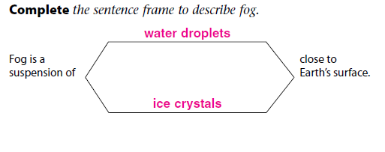
After You Read
Complete
Details; 1) Rain, 2) Sleet, 3) Snow 4) Hail
Label; 1) Evaporation 2) Condensation 3) Precipitation
Label :The water cycle is the series of natural
processes by which water cycles among the land, oceans, and atmosphere.

Slide 6
After You Read
Connect it; Warm air can hold more water vapor than cool air. If the owner increases the air temperature inside the greenhouse and at the same time provides a source of water that could evaporate, humidity inside the greenhouse will increase.

Slide 7
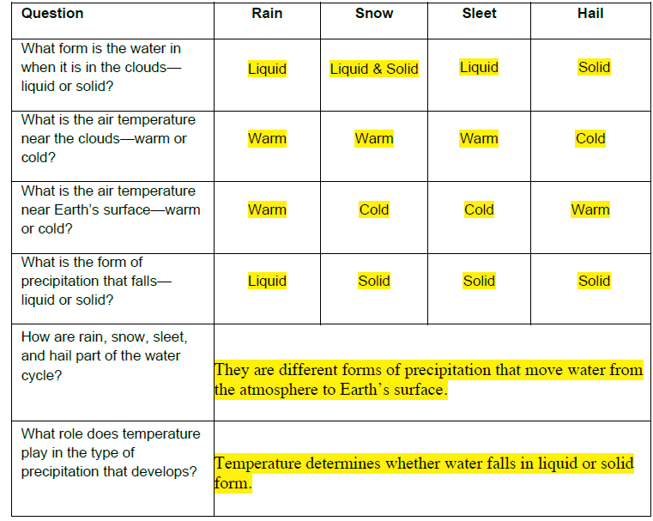
Content Practice A

Slide 8
Content Practice B
1) Air Temperature; Air temperature determines whether precipitation falls as a liquid (rain) or a solid
2) Air pressure is used to predict weather.
3) Wind indicates direction and a change in air pressure.
4) Humidity indicates the amount of moisture in the air and, thus, directly relates to the potential for precipitation

Slide 9
Content Practice B
5) relative humidity is used to predict the possibility of precipitation
6) Dew point indicates the temperature at which precipitation will form
7) The height and type (shape) of cloud are used to predict the type of weather that is possible
8) Fog is clouds that form near Earth’s surface, so it reduces visibility

Slide 10
Content Practice B
9) Precipitation falls as rain, snow, sleet, or hail.
10) The type of weather that a region experiences depends on what is happening at that place in the water cycle.
11) If water is evaporating and the humidity levels are low, then there is no precipitation
12) If water vapor condenses and clouds form, then precipitation will fall.

Slide 11
Brain Pop
1) Video
2) Plicker

Slide 12
Homework

