Slide 1
Warm Up 4 minutes 9-4-18 Tuesday

Slide 2
Warm Up Answer
The mountains are covered in snow, but snow is absent on much of the land near the lake, and the lake is not frozen.
Yes. Near Earth’s surface, air temperature drops with increasing altitude. Air is quite cold at the altitude of clouds, which is why water vapor condenses there.

Slide 3
Today Agenda (44 min)
1) Warm Up 4 min
2) New Chapter Introduction/ Overview 5 min
3) Lesson Notes 20 min
4) Video (5 min)
4) Plicker Practice 10 min
5) Homework Lesson 1 Vocabulary

Slide 4
Earth’s Atmosphere
Chapter Introduction- Tuesday
Lesson 1: Describing Earth’s Atmosphere Wednesday and Thursday
Lesson 2: Energy Transfer in the Atmosphere
(Friday, Monday)
Lesson 3: Air Currents (Tuesday, Wednesday )
Chapter Wrap-Up (Thursday )
Chapter Quiz ( Thursday- Open Notebook)
Chapter Test (Friday)
9 Days Lesson Plan

Slide 5
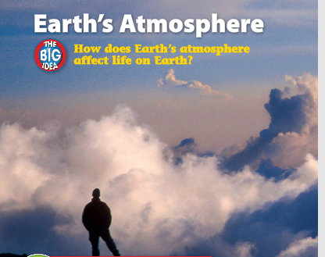
Earth’s Atmosphere- Reward Question (Answer to Science journal)
What’s in the atmosphere?
Look at the photo at the beginning of the chapter. Earth’s atmosphere is made up of gases and small amounts of liquid and solid particles. Earth’s atmosphere surrounds and sustains life.
What type of particles make up clouds in the atmosphere?
How do conditions in the atmosphere change as height above sea level increases?

Slide 6
Earth’s Atmosphere- Science Journal
How does Earth’s atmosphere affect life on Earth?
The gases in Earth’s atmosphere, some of which are needed by organisms to survive, affect Earth’s temperature and the transfer of thermal energy to the atmosphere.

Slide 7
Earth’s Atmosphere- Science Journal
Lesson 1: Describing Earth’s Atmosphere
Earth’s atmosphere formed as Earth cooled and chemical and biological processes took place.
Earth’s atmosphere consists of nitrogen, oxygen, and a small amount of other gases, such as CO₂ and water vapor.
The atmospheric layers are the troposphere, the stratosphere, the mesosphere, the thermosphere, and the exosphere.
Air pressure decreases as altitude increases. Temperature either increases or decreases as altitude increases, depending on the layer of atmosphere.

Slide 8
Earth’s Atmosphere- Science Journal
Lesson 2: Energy Transfer in the Atmosphere
The Sun’s energy is transferred to Earth’s surface and the atmosphere through radiation, conduction, convection, and latent heat.
Air circulation patterns are created by convection currents.

Slide 9
Video-Introduction to Our Atmosphere
https://www.youtube.com/watch?time_continue=3&v=I6jIMkPwahQ

Slide 10
Plicker

Slide 11
Homework
Lesson 1 Vocabulary

