Slide 1
9/22/2016 Wednesday Warm Up
1) What type of weather would a cirrus cloud bring?
2) Which type of cloud vertically developed and results in thunderstorm?
3) Which type of cloud looks feathery and wispy?

Slide 2
Answer
1) Neutral/fair weather
2) Cumulonimbus
3) Cirrus

Slide 3
9/22/2016 Thursday Warm Up
1)What is an air mass?

Slide 4
Page 84
Air mass; a large body of air with relatively the same temperature and humidity.
An air mass sits over a region for extended period of time and picks up the characteristics of that region . This is called Source Region.

Slide 5
Page 84-85
Type of air mass is cold and warm air.
There are 4 type of source region.
Maritime; forms over water; wet
Continental; forms over land;dry
Polar; (Artic/Antarctic ) forms over the polar regions; cold
Tropical; develops over the tropics.

Slide 6
Page 85
COLD AIR MASS
mP Maritime ,Polar (Wet, cold air )
cP Continental ,Polar ( dry and cold )
WARM AIR MASS
cT Continental ,Tropical ( dry and warm)
mT Maritime, Tropical ( Over the ocean , wet and warm)

Slide 7
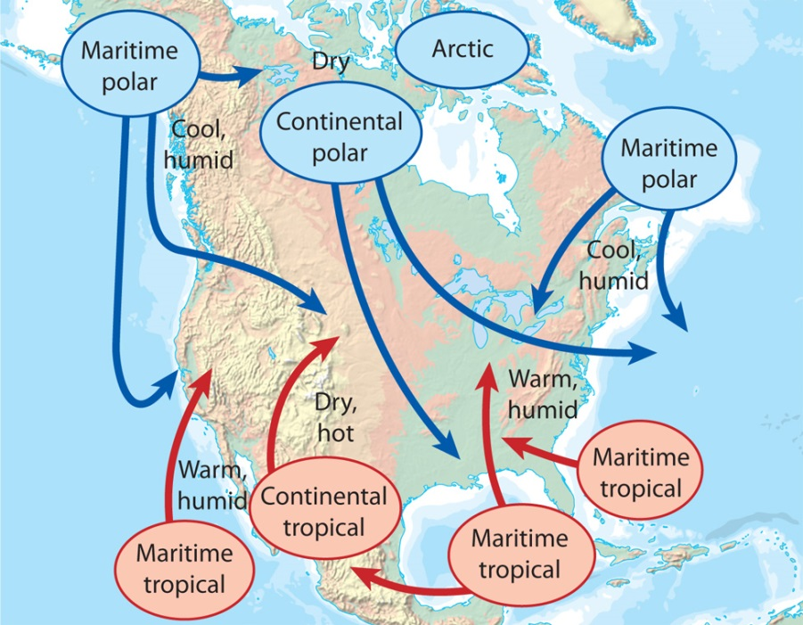

Slide 8
Page 86
Front; A dividing line between two different air masses. A boundary between two air masses.
Four types of front; cold fronts, warm fronts, occluded fronts, stationary fronts.

Slide 9
Page 86
Cold Front; Cold air moves under warm air. This front brings thunderstorms.
Warm Front; warm air pushes overtop a colder air mass. Bring drizzly rain, warm weather.

Slide 10
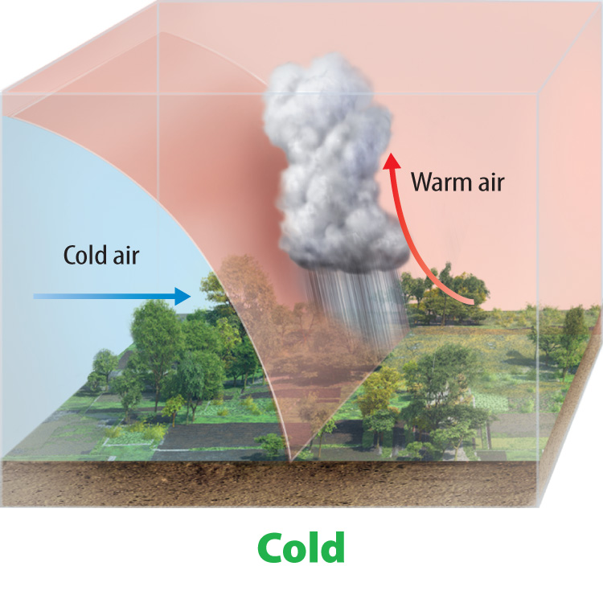
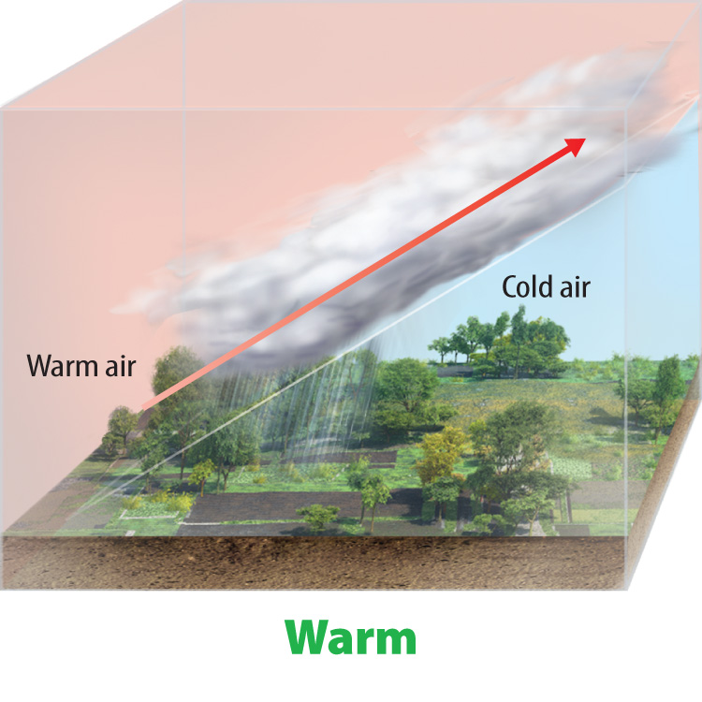

Slide 11
Page 87
Occluded front occurs when a cold front overtakes a warm front. In other words, warm air mass is trapped between two cooler air masses.
Stationary Front; it forms when a cold air mass meets to a warm air mass. They remain separated. Brings cloudy, wet weather.

Slide 12
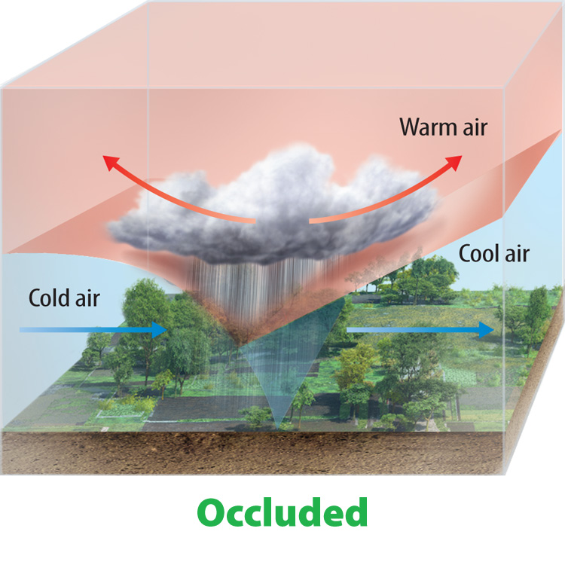
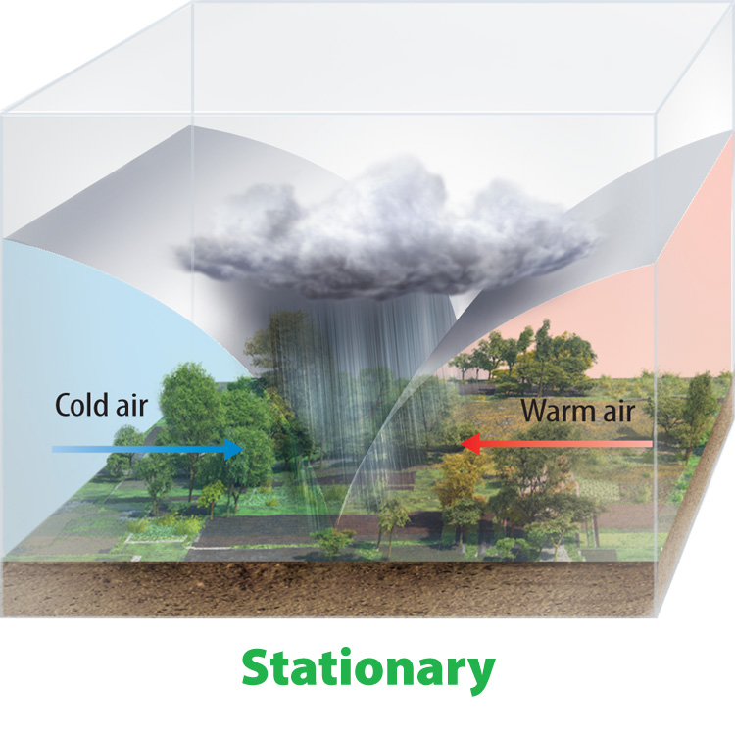

Slide 13
Page 88
Cyclone; an area in the atmosphere that has lower pressure than the surrounding areas and has winds that spiral toward the center.
Anticyclone; The rotation of air around a high pressure center in the direction opposite to Earth’s rotation.

Slide 14
Summary
Air masses are characterized by moisture content and temperature
A front occurs where two air masses meet.
Four major types of fronts are cold, warm, occluded, and stationary.

