Slide 1
Benchmark Study Guide answer
1) What are the two most abundant gases in the atmosphere? What else makes up our atmosphere?
Answer: Nitrogen 78% Oxygen 21% other (CO2, Ozone and Argon 1%)

Slide 2
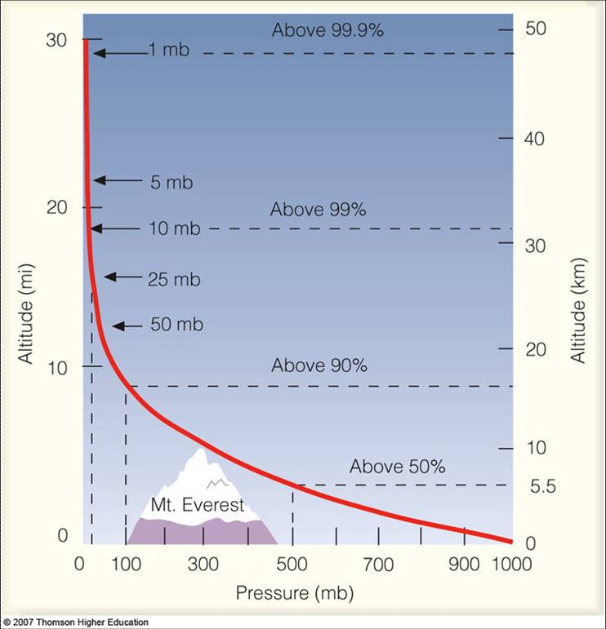
Benchmark Study Guide answer
2)How does air pressure change as you go up in the atmosphere? Why?
The molecules that make up the atmosphere are pulled close to the earth's surface by gravity. ... Air pressure is a measure of the weight of the molecules above you. As you move up in the atmosphere there are fewer molecules above you, so the air pressure is lower..

Slide 3
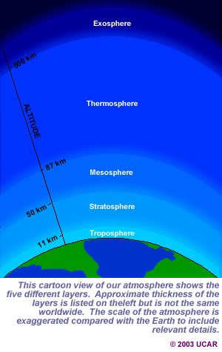
Benchmark Study Guide answer
3)List the layers of the atmosphere in order of increasing altitude.
Troposphere. ...
Stratosphere. ...
Mesosphere. ...
Thermosphere. ...
Exosphere.

Slide 4
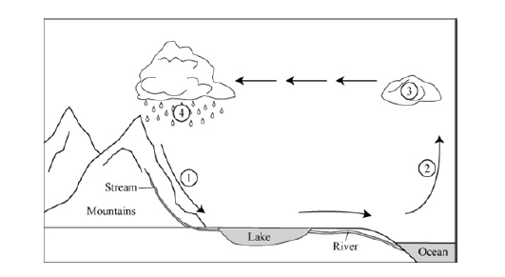
Benchmark Study Guide answer
4) Label the parts of the water cycle in the diagram below.
1
1
11111111111111111111111111111111111
1) Transportation 2) Evaporation 3) Condensation 4) Precipitation

Slide 5
Benchmark Study Guide answer
5)What are the four main types of clouds? Draw a picture of each and write what type of weather they bring.

Slide 6
Benchmark Study Guide answer
6) What is the source region of an air mass?
Polar (P) or Tropical air (T), and on the nature of the surface in the source region: continental (c) or maritime (m).
cP: continental Polar continental Tropical mP: maritime Polar mT: maritime Tropical

Slide 7
Benchmark Study Guide answer
7)The boundary between two air masses is called a _____.
Front

Slide 8
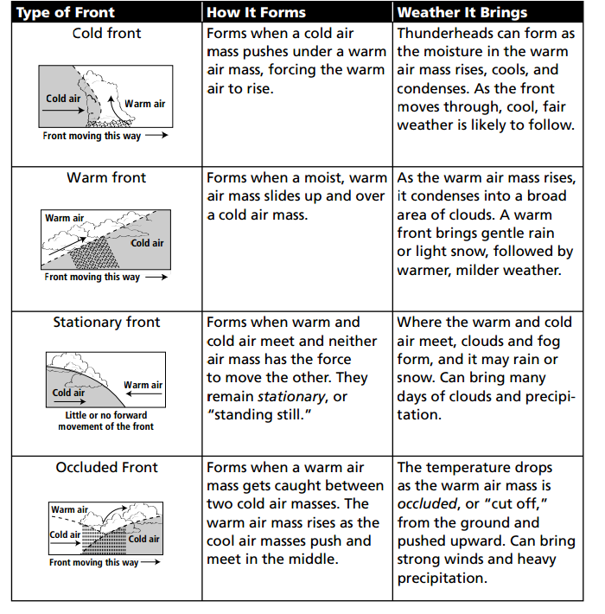
Benchmark Study Guide answer
8)Describe the four types of fronts and the weather you would expect with each.

Slide 9
Benchmark Study Guide answer
9) What is the Coriolis Effect?
Responsible for large scale weather patterns and legendary cause of the direction the water swirls down the sink.

Slide 10
Benchmark Study Guide answer
10) Winds typically move from _______ to _______ across the United States.
Answer : West to East (Westerlies)

Slide 11
Benchmark Study Guide answer
11) What relative humidity? Can warm air or cold air hold more water vapor?
Answer; the amount (percentage) of water vapor the air is holding compared to the amount it could hold.
There’s the same amount of moisture, but the relative humidity of the heated air is much less —the warmed air can “hold” a good deal more moisture than the cool air

Slide 12
Benchmark Study Guide answer
12) What is dew point?
Answer; The temperature at which the water vapor in the air becomes saturated and condensation begins

Slide 13
Benchmark Study Guide answer
13) Meteorologists use _______ to measure air pressure, ________ to measure humidity, _________ to
measure temperature and ________ to measure wind speed.
Answer; Barometer, Psychrometer, Thermometer, Anemometer

Slide 14
Benchmark Study Guide answer
14)What are isobars? What are isotherms?
Answer; Isobars and isotherms are lines on weather maps which represent patterns of pressure and temperature, respectively.

Slide 15
Benchmark Study Guide answer
15)On a weather map, a capital “H” means __________ and an “L” means__________.
Answer; High Pressure, Low Pressure

Slide 16
Benchmark Study Guide answer
16) What is ozone? Where is it located?
Ozone layer is in the stratosphere about 20-30 km above Earths surface. Provides protective layer = acts as a shield absorbing around 90% of UV rays.

Slide 17
Benchmark Study Guide answer
17) What happens when ozone is ground level?
Unlike the good, protective ozone layer in the stratosphere, ground level ozone is a harmful air pollutant that affects all of us. It's formed when emissions from everyday items combine with other pollutants and “cook” in the heat and sunlight.

Slide 18
Benchmark Study Guide answer
18) Describe the greenhouse effect. What gases are greenhouse gases?
The "greenhouse effect" is the effect of atmospheric gases like CO2, O3, and methane absorbing energy from the sun and earth and "trapping" it near the Earth's surface, warming the Earth to a temperature range that is hospitable for life.

