Slide 1
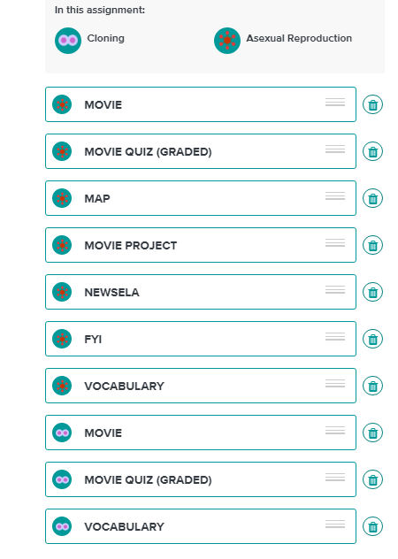
Brain Pop Assignment-Due Date 12/1/17
There are 10 items on the list and each one of them is 10 points.
I will put the grade Friday.

Slide 2
Brain Pop
1) If you have an account log in and start your asexual reproduction assignment.
2) You can ask me your username and password .(Email; ailbay@tmsacharter.org)

