Slide 1
Blood Vessels
1)Arteries:
Function: carry blood away from heart
Pulse: the alternating expansion and relaxation of the artery wall
2)Veins:
Function: carries blood to the heart
3) Capillary:
Function materials can be exchanged between blood and other cells

Slide 2
Direction of Blood Flow
1. Heart (pumps blood out and receives blood back)
2. Arteries: Right ventricle: blood goes to lungs
Left ventricle: blood goes to body
3. Capillaries :Exchange of materials (oxygen & carbon dioxide)
4. Veins: Blood returns to heart.

Slide 3
Blood Cells
Red Blood Cells: Carry oxygen from lungs to body cells, produced in bone marrow
White Blood Cells : Body’s disease fighters, larger than red blood cells
Platelets: Cell fragments, helps to form blood clots

Slide 4
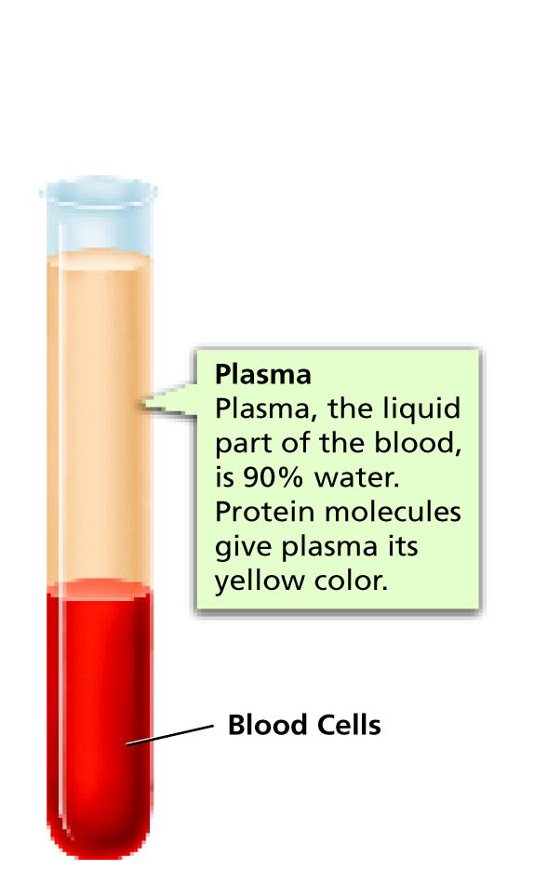
Plasma
Liquid part of blood
Mostly water
Contains dissolved materials:
Protein gives plasma a yellowish color

Slide 5
Lymph System and Blood Types
Blood Types
Blood & Lymph System
Percent of Population
Blood A; 40%
Blood B: 11%
Blood AB: 4%
Blood O: 45%
Fluid leaks out of the blood into surrounding tissues as it circulates is called lymph
The lymphatic system is a network of vein-like vessels that return the lymph to the blood stream

