Slide 1
Functions of the Digestive System
1.It breaks down food into molecules the body can use.
2. The molecules are absorbed into the blood and carried throughout the body
3. Wastes are eliminated from the body.

Slide 2
Definitions:
Digestion: process by which your body breaks down food into small nutrient molecules.
Absorption: the process by which nutrient molecules pass through the wall of your digestive system into your blood.

Slide 3
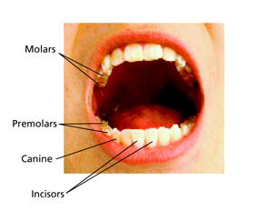
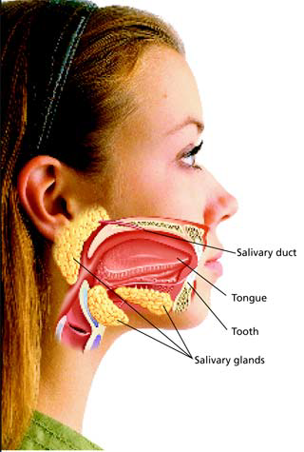
The Mouth
Mechanical Digestion: Teeth tear/slash food into smaller particles
Chemical Digestion: Saliva is produced

Slide 4
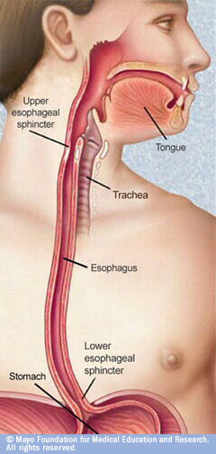
The Esophagus
A muscular tube that connects the mouth to the stomach
Contractions of the smooth muscle pushes the food forward (peristalsis)

Slide 5
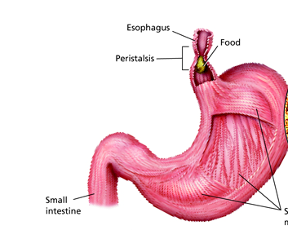
The Stomach
Churning of food (mechanical) and mixing with digestive juices (chemical)
Main digestive juice: acid

Slide 6
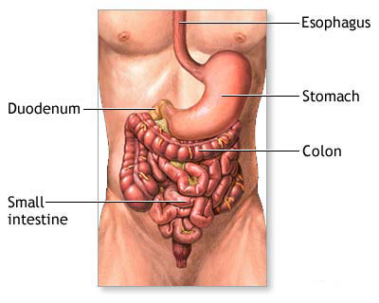
Small Intestine
Most chemical digestion takes place as well as absorption

Slide 7
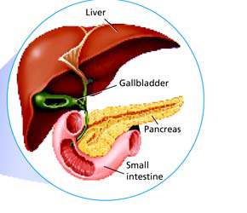
Liver
Bile is a substance that breaks up fat
• Stored in the gallbladder, then secreted into small intestine when food is present.

Slide 8
Pancreas
Produces enzymes that help break down starches, proteins and fats.

Slide 9
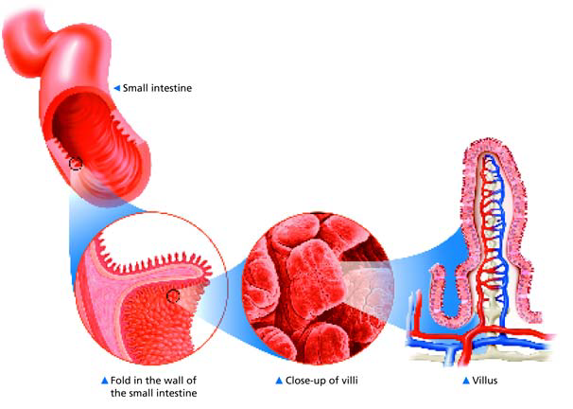
Absorption in the Small Intestine
Villi increase the absorption surface area

Slide 10
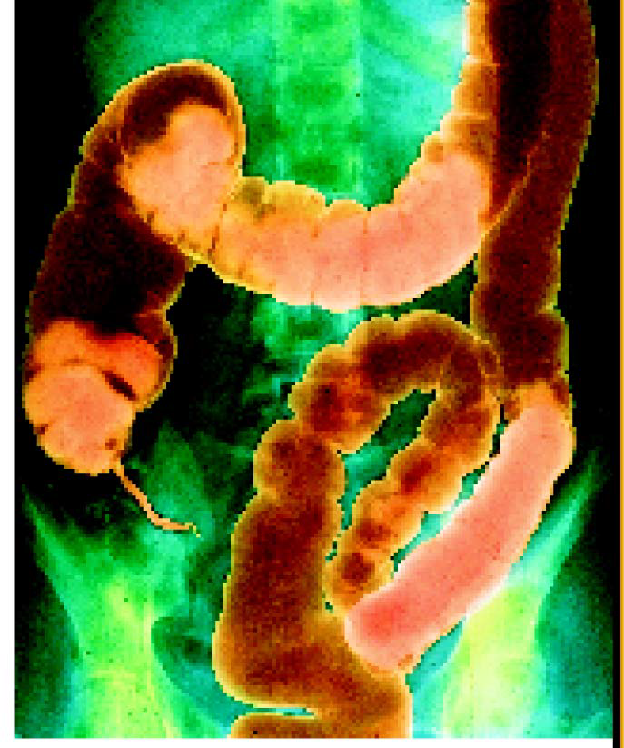
The Large Intestine
Water is absorbed, the rest is passed out of the body.
• Bacteria in the large intestine will help break down some waste.

