Slide 1
Warm Up 10/17/16 Monday
What is the function of microscope?

Slide 2
Answer
Magnify small things bigger to understand their structure better.

Slide 3
Today Agenda
1) Cell Theory
All Living Things are Composed of Cells
A Cell is the Smallest Part of Any Living Thing
Cells Came From Other Living Things

Slide 4
Video and Activity
Video
Worksheet
Reading Package

Slide 5
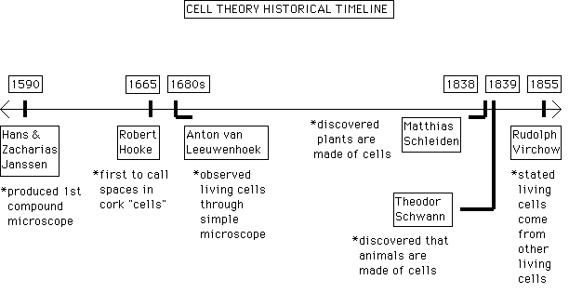
Timeline Answer
Answers

Slide 6
Question Answer
What theory did these scientists provide evidence for?
the cell theory

Slide 7
Question 2
What instrument was necessary before the cell theory could be developed?
The microscope

Slide 8
Question 3
Which three scientists directly contributed evidence for the cell theory?
Matthias Schleiden, Theodor Schwann, Rudolph Virchow

Slide 9
Question 4
How did the earlier scientists and their contributions directly affect the discoveries of later scientists? For example, what had to come first?
Hans and Zacharias Janssen had to first develop the microscope before cells could be discovered. Robert Hooke then discovered empty, dead cork cells in tree bark. Anton van Leeuwenhoek discovered the existence of living cells and is sometimes given credit for the microscope.

Slide 10
Question 5
List the three parts of the cell theory.
1)All living things are made of cells. 2)Cells are the basic units of structure and function in living things. 3)Living cells come only from other living cells

Slide 11
Summary
Cells were first observed under a light microscope, but today’s electron microscopes allow scientists to take a
closer look at the inside of cells.
• Cell theory says that:
– All organisms are composed of cells.
– Cells are alive and the basic living units of organization in all organisms.
– All cells come from other cells.
• Cells are organized into tissues, which are organized into organs, which are organized into organ systems,
which are organized to create the whole organism.

Slide 12
Review
1. What type of microscope would be best for studying the structures found inside of cells?
2. What are the three basic parts of the cell theory?
3. According the cell theory, can you create a cell by combining molecules in a laboratory? Why or why not?

Slide 13
Answer
1)Electron Microscope
2) All organisms are composed of cells.
– Cells are alive and the basic living units of organization in all organisms.
– All cells come from other cells.
3)You cannot because all cells come from other cells and they are alive and basic living units of organization in all organisms.

