Slide 1
WARM UP 5 MINUTES
8-28-17 MONDAY

Slide 3
ANSWER (You can write the red part)
1) The eagle is soaring or gliding as it spreads its broad wings and tail. By observing the eagle over time, you could learn how it climbs or dives, where it builds its nest, and how it catches fish or other prey
2) How long can the eagle stay in the air before it must rest?
How does the eagle use its pointed beak?
To find the answers to these and other questions, you could research them in books, encyclopedias, or trusted web sites. Many questions could be answered by observing bald eagles.
3) As the human population grows, the natural habitats of many animals are changing or being destroyed. By studying how animals live, we can take actions to help them survive.

Slide 4
Today Agenda
1) Warm Up 5 minutes
2) Introduction 10 minutes
3 ) Instruction 20minutes
4) Independent Practice 10 minutes

Slide 5
Scientific Explanations
Chapter Introduction
Lesson 1: Understanding Science
Lesson 2: Measurement and Scientific Tools
Lesson 3: Case Study

Slide 6
Scientific Explanations
How can science provide answers to your questions about the world around you?
The process of scientific inquiry and performing scientific investigations can provide answers to questions about your world.

Slide 7
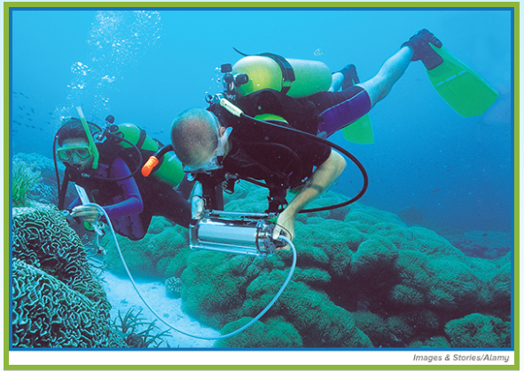
Scientific Explanations
Vacuuming Corals?
Look at the photo at the beginning of the chapter. These two divers are collecting data about corals in waters near Sulawesi, Indonesia. They are marine biologists, scientists who study living things in oceans and other saltwater environments.
What information about corals are these scientists collecting?
What questions do they hope to answer?
How can science provide answers to their questions and your questions?

Slide 8
1
Understanding Science
What is scientific inquiry?
What are the results of scientific investigations?
How can a scientist prevent bias in a scientific investigation?
(You are going to write these question and answer when the review time comes. ) Science Journal

Slide 9
1
Understanding Science
science
observation
inference
hypothesis
prediction
technology
scientific theory
scientific law
critical thinking

Slide 10
1
Understanding Science- Vocabulary –Science Journal
Science; Science is the investigation and exploration of natural events and of the new information that results from those investigations.
Biology study of all living things; life science
Critical thinking comparing what you already know with the information you are given to decide whether you agree with it
Ethics: rules of conduct or moral principles
Hypothesis possible explanation about an observation that can be tested by scientific investigations

Slide 11
1
Understanding Science
D. Results of Scientific Inquiry
1. Outcomes of scientific inquiry may include technology, new materials, and possible explanations for phenomena.
2. The practical use of scientific knowledge, especially for industrial or commercial use, is called technology.

Slide 12
1
Understanding Science
E. Scientific Theory and Scientific Laws
1. An explanation of observations or events based on knowledge gained from many observations and investigations is called a(n) scientific theory.
2. A(n) scientific law describes a pattern or an event in nature that is always true.
3. It is important to be skeptical, or to question information, about scientific issues presented in the media.
4. Comparing what you already know with the information you are given in order to decide whether you agree with it is called critical thinking.
5. Science cannot answer questions about personal opinions, values, beliefs, or feelings.
6. Scientists follow safety procedures when they conduct investigations.
7. It is important to follow ethics when you work with living things or do research with people.

